Slide 1
ONLINE CLASS
GRAPH THEORY
BICTE $6^{TH}$ SEMESTER
2078/03/22
PRESENTED BY KALYAN DAHAL

Slide 2
Planarity Testing
The Corollaries 1, 2 and their generalization are often useful for showing that graph is not planar. Unfortunately, there are many graphs which satisfy these inequalities but are not planar. Therefore, we need other way to decide planarity.
Some important observations:
Observation 1
Not all graphs are planar.
For example, we know K₅ and K_{3,3} are not planar.

Slide 3
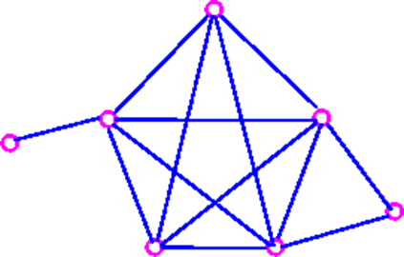
Continued…
Observation 2
If G is a planar graph, then every subgraph of G is planar;
We usually stated observation 2 as follows
Observation 2a
If G contains a nonplanar graph as a subgraph, then G is non-planar. For example, following graph is nonplanar

Slide 4
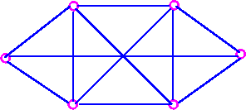
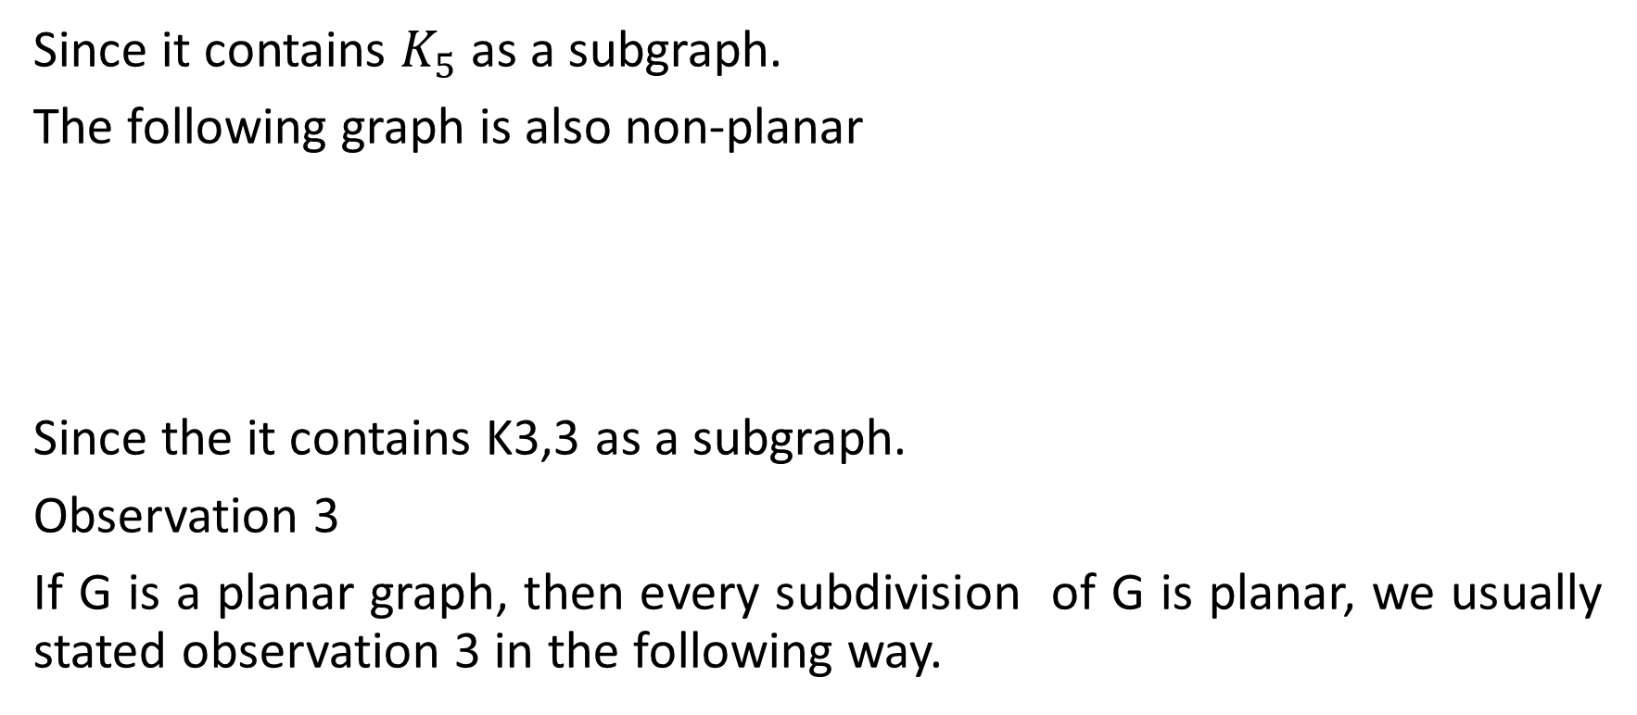
Continued…
Since it contains $K_{5}$ as a subgraph.
The following graph is also non-planar
Since the it contains K3,3 as a subgraph.
Observation 3
If G is a planar graph, then every subdivision of G is planar, we usually stated observation 3 in the following way.

Slide 5
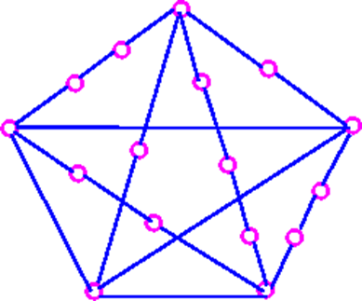
Continued….
For example, following graph is non-planar,
Since it is a subdivision of K₅.
Also, the following graph is non-planar,

Slide 6
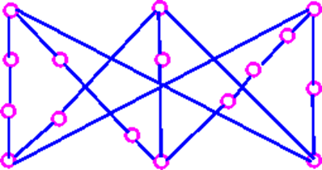
Continued….
Since it is a subdivision of K_{3,3}.
It follows from observations (2a) and (3a) that, if any graph G contains a subdivision of K₅ and K_{3,3} as a subgraph, then G must be non-planar.

Slide 7
Continued….
Why are we so obsessed with K₅ and K_{3,3}? The reason is that all non-planar graphs can be obtained by adding vertices and edges to a subdivision of K₅ and K_{3,3}.
Every non-planar graph contains K₅ or K_{3,3} as a subgraph.
Duality
Given a connected planar graph G, we construct dual graph G* in three stages.
Take a plane drawing of G.
Choose one point inside each face of the plane drawing - these points are the vertices of G*.
For each e of the plane drawing, draw a line connecting the vertices of G* on each side of e.

Slide 8
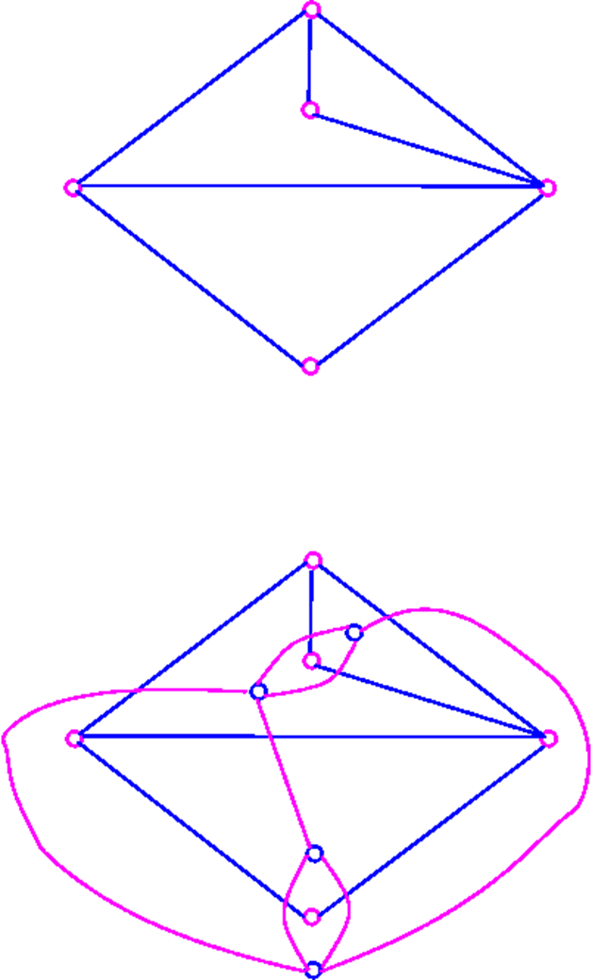
Continued….
This procedure is illustrated as follows:

Slide 9
Continued….
Note that each plane drawing of G given rise to just one dual graph G*.
If G is a connected planar graph with n vertices, f faces and m edges, then G* has f vertices, n faces and m edges.
G has 5 vertices, 4 faces and 7 edges, and G* has 4 faces, 5 faces, and seven edges.
that if G is a connected planar graph, then G* is also connected planar graph.

Slide 10
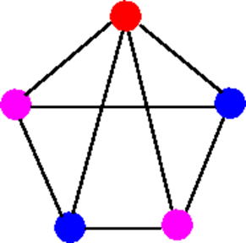
Vertex Coloring
Let G be a graph with no loops. A k-coloring of G is an assignment of k colors to the vertices of G in such a way that adjacent vertices are assigned different colors. If G has a k-coloring, then G is said to be k-coloring, then G is said to be k-colorable. The chromatic number of G, denoted by X(G), is the smallest number k for which is k-colorable. For example,
3-coloring

Slide 11
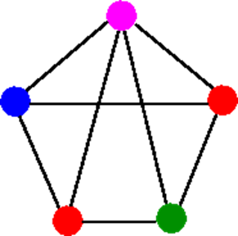
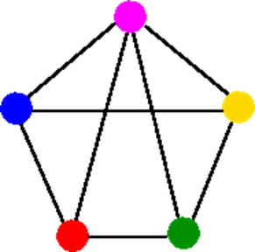
Continued…
4-coloring
5-coloring

Slide 12
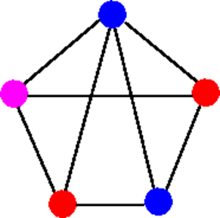
Continued…
Not a permissible coloring, since one of the edge has color blue at both ends.
It is easy to see from above examples that chromatic number of G is at least 3. That is X(G) ≤ 3, since G has a 3-coloring in first diagram. On the other hand, X(G) ≥ 3, since G contains three mutually adjacent vertices (forming a triangle)., which must be assigned different colors. Therefore, we have X(G) = 3.

Slide 13
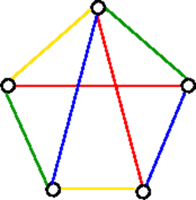
Edge Colorings
Let G be a graph with no loops. A k-edge-coloring of G is an assignment of k colors to the edges of G in such a way that any two edges meeting at a common vertex are assigned different colors, If G has a k-edge coloring, then G is said to be k-edge colorable. The chromatic index of G, denoted by X`(G), is the smallest k for which G is k-edge-colorable. For example, consider the following graphs with eight edges:
4-edges-coloring

Slide 14
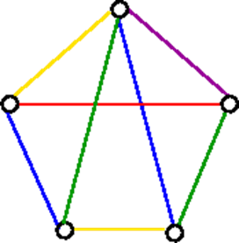
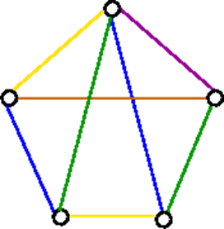
Continued…
5-edge-coloring
6-edge-coloring

Slide 15
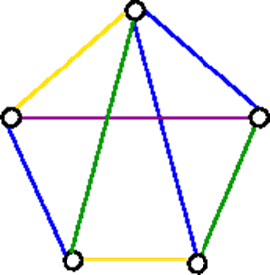
Continued…
Not a permissible coloring. Since two of the edges colored blue meet at a common vertex
From the above examples, it follows that X`(G) ≤ 4, since G has a 4-edge-coloring in figure a (above). On the other hand, X`(G) ≥ 4, since G contains 4 edges meeting at a common vertex i.e., a vertex of degree 4, which must be assigned different colors. Therefore, X`(G) = 4.

Slide 16


